Slide 1

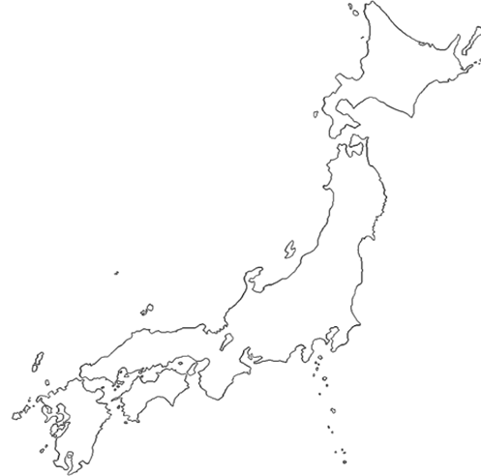
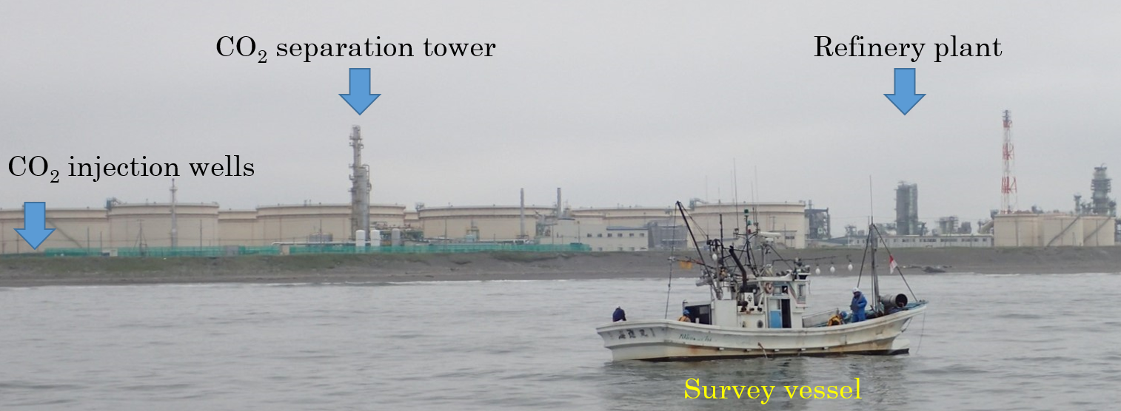
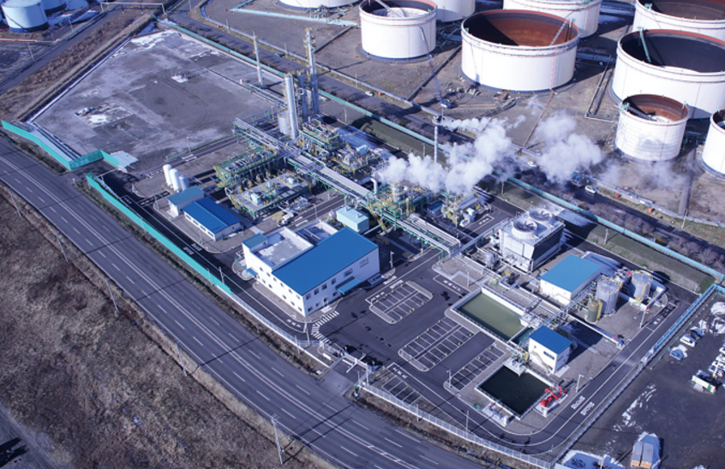
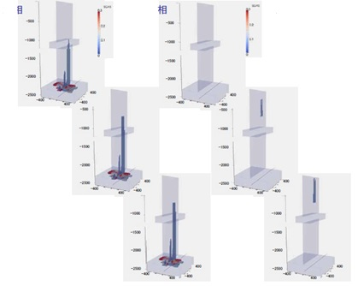
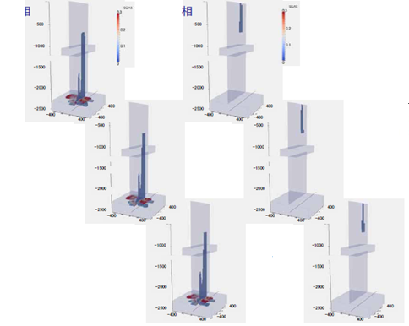
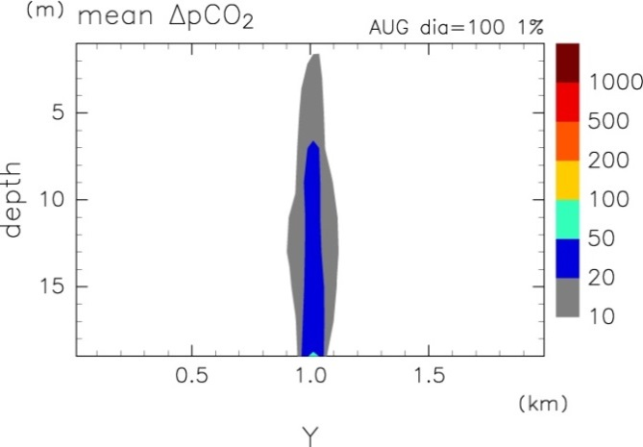
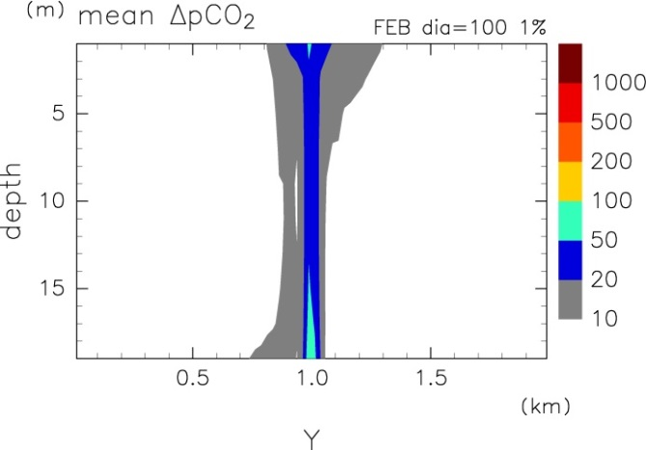
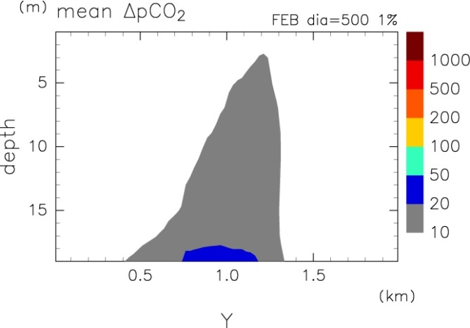
Tomakomai CCS Demonstration Project
- Environmental Impact Assessment and Leakage detection -
Jun Kita (kita@kaiseiken.or.jp), Marine Ecology Research Institute
1. Tomakomai CCS Demonstration Project
3. 3. Example of threshold for ecological impact
Tomakomai
Demonstration Project
Off-gas supply: Hydrogen production facility at oil refinery plant
Table. Summary of elevated-CO₂ effects on various marine organisms estimated
from recent papers.
CO₂ capture: Amine absorption
Organisms | pCO₂ | Effect
Calcifiers Molluscs Echinoderms Corals Coccolithophores | Δ200μatm < | Calcification decrease
Non-calcifiers Fish Molluscs Copepods | Δ2,000μatm < | Physiological disturbance
Nagaoka
Pilot Scale Project
800 km
CO₂ injection: Onshore
Tokyo
Reservoirs: under the seabed
• Sandstone layer: 1100-1200m depth
• Volcanic rocks layer: 2400-3000m depth
Even in the extreme leakage scenario it was concluded that the impact on the ecosystem was negligible.
4. Monitoring program required in the ACT
Conformance:
Observed behavior of CO₂ in the reservoir should fall into line with predictions.
Containment:
Secure retention of CO₂ in the reservoir should be demonstrated.
Distribution of CO₂ in the reservoir needs to be tracked.
No signs of leakage needs to be shown in the marine environment.
Contingency:
If leakage does occur,
Amount of leakage needs to be quantified.
Any environmental impacts need to be assessed.
The onshore Nagaoka Pilot Scale Project was carried out from 2003 to 2005, with a total of 10,000 tonnes CO₂ injected in a saline aquifer. The project successfully demonstrated that injected CO₂ was safely stored in the reservoir.
The offshore Tomakomai Demonstration Project was started by the Ministry of Economy, Trade and Industry, METI, for the period 2012 -2020 to demonstrate and verify the total CCS system. The operator of the project is Japan CCS Company. It is planned that 100,000 tonnes/year or more CO₂ is to be stored under the seabed. CO₂ injection started in early April 2016 and will continue to 2018.
2. Regulation for offshore CO₂ storage in Japan
Act for the Prevention of Marine Pollution and Maritime Disasters
May 2007: The act was amended to allow a permitting procedure for dumping the CO₂ stream into sub-seabed formations in accordance with London Protocol.
Seeks to prevent marine environmental impacts from potential CO₂ leakage
Operator of Offshore CO₂ storage,
Shall receive permission from the environmental minister.
Shall implement an Environmental Impact Assessment.
Shall monitor the surrounding sea environment for assurance of no-leakage.
4. 1. Required monitoring items
CO₂ injection:
Volume (flow meter), concentration (gas chromatography),
injection condition (pressure, rate, temperature)
Wellbore condition:
Pressure and Temperature of injection well and observation well
Reservoir:
Location and dimension of stored CO₂ (time-lapse (4D) seismic)
Marine environment:
Seawater chemistry (pH, TCO₂, Alkalinity, DO, etc.)
Maine biota (micro-, meio-, macro-, mega-benthos)
Marine activities (fisheries, maritime affairs, protected reserves, etc.)
3. Environmental Impact Assessment (EIA) in the ACT
Objective: Estimation of CO₂ dispersion and assessment of environmental impact assuming that stored CO₂ leaks out into the sea
Process:
Consideration of leakage scenarios and their simulation
  CO₂ migration in the geological formation
  CO₂ dispersion in the seawater column
Base-line survey for the existing marine environment
Impact assessment
4. 2. Tiered monitoring plan in the Act
Three-tiered monitoring plan must be implemented depending on the severity of changes that could occur following CO₂ storage
Routine monitoring:
When: No indication of leakage
How: Distinguish leakage signal from natural variability
Precautionary monitoring:
When: Possible leakage
How: Confirm existence or non-existence of leakage
Emergency monitoring:
When: Leakage has taken place
How: Determine location and extent of the leakage and its impact
3. 1. Simulation for CO₂ migration in the geological formation
  Scenario: Leakage through faults undetectable by seismic survey
  Simulator: TOUGH2 with ECO2M (LBNL)
  Output: CO₂ flux at the seafloor
Liquid phase
1.5 yrs
Gas phase
Liquid phase
16 yrs
Gas phase
4. 3. Leakage detection by seawater quality
The regulatory authority strongly urged the use of the relationship between concentrations of oxygen and carbon dioxide to detect leakage. Since the baseline data did not fully reflect the natural variation, false positive occurred. Ultimately, the observed value (false positives) were judged to be within the range of natural variation by the expert judge. In other words, no leakage was confirmed.
5 yrs
30 yrs
10 yrs
40 yrs
Baseline data
Fig. Simulations show that stored CO₂ never reaches the seafloor through small faults that are undetectable by seismic surveys. These figures were only derived under extreme leakage scenarios.
Monitoring data
3. 2. Simulation for CO₂ dispersion in the seawater
Input: CO₂ flux at the seafloor
Simulator: MEC-CO2 two-phase flow model (Kano et al., 2010, IJGGC, 3,
617-625.
Output: CO₂ concentration gradient in the seawater column
Monitoring data
False positive
Approximate curve
of baseline data
Upper 95% prediction
interval of baseline data
Fig. Relationship between oxygen saturation (DO) and CO₂ partial pressure (pCO₂) of
bottom seawater (2 m above the seafloor).
5. Lessons learned
If the baseline data does not fully reflect the natural variation, occurrence of false positives or false negatives will be high.
Further studies are needed for collecting appropriate baseline data to detect leakage by seawater quality analysis.
Integrated review, i.e. not only analysis of seawater but also monitoring data of CO₂ injection, wellbore and reservoir, should be considered for leakage detection.
Fig. X axis shows seafloor and Y axis shows depth of seawater. Left and middle figures
indicate leakage from 100m diameter circle area. Left is for a summer condition and
middle is for a winter. Right figure indicates leakage from a 500m circle area in winter.

